Slide 1




IOT BASED SMARTWATER TANK MONITORING & CONTROLLING
IOT
Notes:
1

Slide 2


INTRODUCTION:-
Nowadays everybody has overhead tank at their homes. But everyone who has a water tank above knows the kind of problems that they face. Firstly there is no system to track the water in the tank.
Then there come a secondary problem that is when their water pump is started they have no idea when it gets filled up and sometimes there are situation where the pump keeps on pumping water to the tank and the water starts spilling out from the tank. There is wastage of energy as well as wastage of water.
Notes:
16

Slide 3
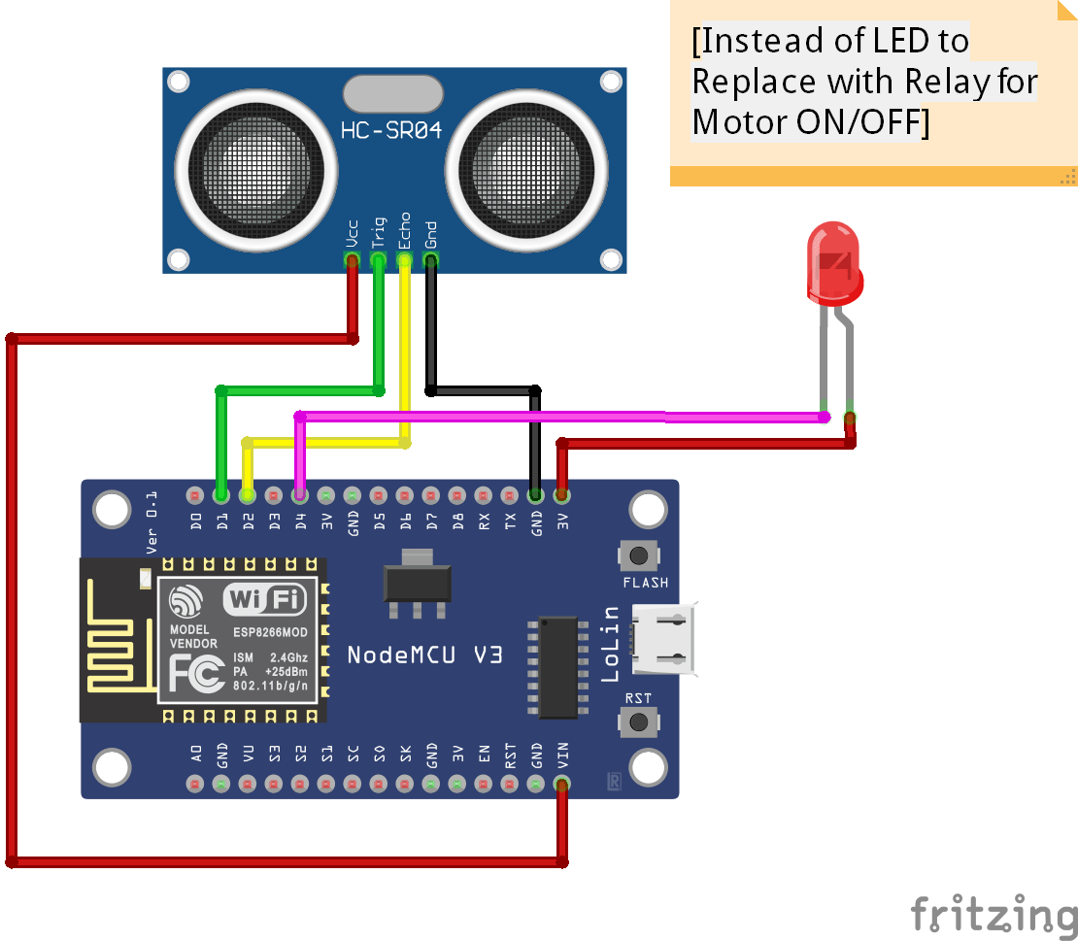
CIRCUIT DIAGRAM:-
Notes:
4

Slide 4

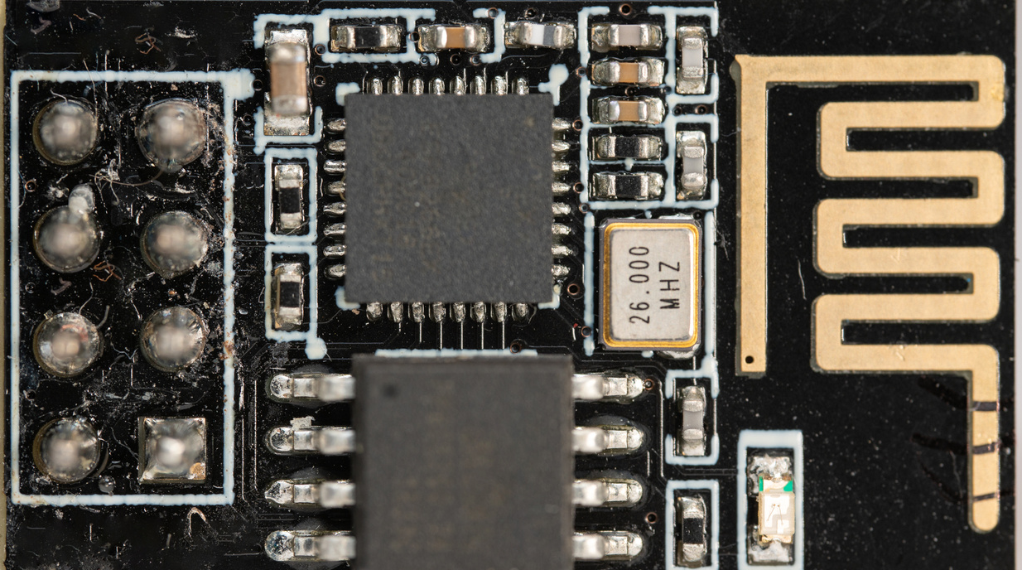


COMPONENTS USED:-
Ultrasonic sensor HC-SR04
Node MCU
Relay Module
Jumper wires
Pump Motor
Notes:
6

Slide 5
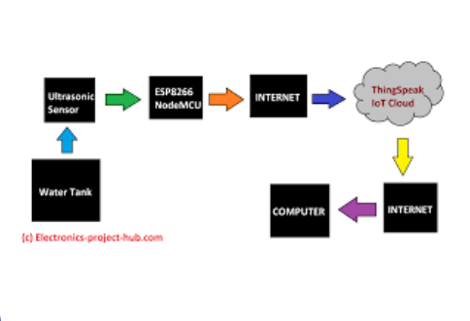
DESCRIPTION:-
IoT-based water level monitoring provides automatic detection of liquid levels from differently sized tanks or storage containers.
It is a state-of?the-art system specially designed to inform the users about the real status of the liquid levels
Notes:
8

Slide 6
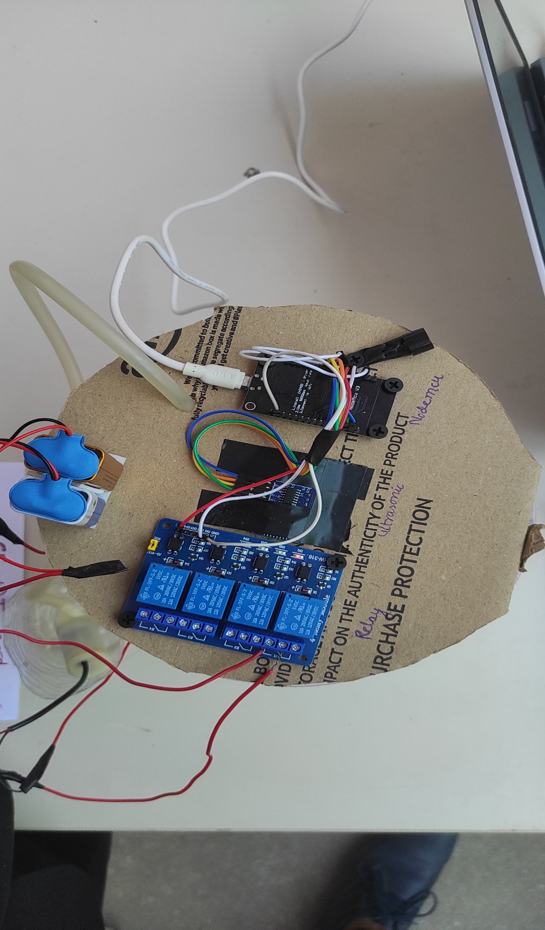
WORKING:-
When the pump get started,the water starts to get filled in the tank and when the water level in the tank starts to rise up, what happens is that the sensors that is installed in the tank starts to get activated one by one indicating the water level in the tank.
And finally when it reaches to its top most sensor, there will be a visual display as well as a sound from the unit indicating that the water has filled in the tank and one can be alerted that the tank has been filled up and the water pump has to be switched off saving the electricity bill as well asover flow of water from the tank.
Notes:
9

Slide 7
ADVANTAGES:-
Overflow problems
To prevent wastage of energy
To prevent wastage of water
Attention
Observation
Automatic switch off
Notes:
15

Slide 8

FUTURE SCOPE:-
This circuit not only indicates the amount of water present in the overhead tank but also gives an alarm when the tank is full.
This worthy device starts ringing as soon as the water tank becomes full.
It helps to check overflow and wastage of water by warning the customer when the tank is about to brim.
It also provides automatic control of pumps at a remote location.
Notes:
10

Slide 9
REAL TIME EXAMPLE:-
Connecting it it cloud server
Real Time Example we can connect it to our mobile and our pc through blynk IOT as it is free and open source software.
we can manage our dad so that the motor automatically on or off when the water level is low.
Notes:
3

Slide 10
PRESENTED BY:-
TEAM DRACARYS
K . ROHITH (TEAM LEAD)
A . PRANAY
M . RAJU ( TEAM CO-ORDINATOR)
S . ANIL
K . KARTHIKEYA
Notes:
11

Slide 11

THANK YOU
Notes:
14

